Slide 1
Module 1: Properties and Handling of Particulate Solids (Chapter 28)
Lecture 5
Somak Chatterjee

Slide 2
Size reduction
Cutting or breaking solids into smaller pieces – called as “comminution”
Reasons for size reduction
  To get workable size
  To increase the reactivity
  To separate unwanted ingredients by mechanical methods
  To handle and dispose easily.

Slide 3
Objectives of size reduction
To increase the surface area, because in most chemical reactions and some unit operations (drying, adsorption, leaching etc.) involving solid particles, reaction/transfer is directly proportional to the area of contact between the solid and the second phase.
To produce solid particles of desired shape, size or size ranges, and specific surface
To separate unwanted particles effectively
To dispose solid wastes easily
To mix solid particles more intimately
To improve the handling (storage and transportation) characteristics.

Slide 4
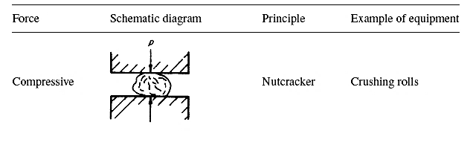
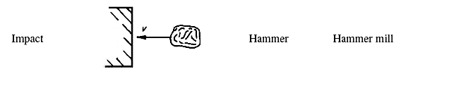
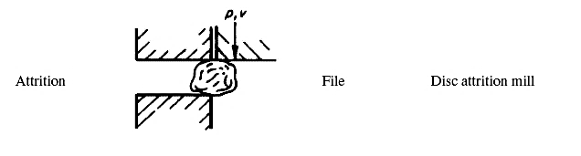
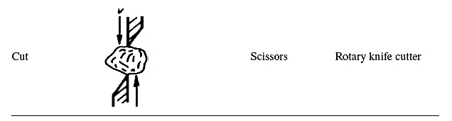
Principles used in size reduction
Compression
  Nutcracker: for coarse reduction of hard solids giving very few fines
Impact
  Hammer: gives coarse, medium and fine products
Attrition or rubbing
  File: gives a very fine products
Cutting or Shear
  A pair of shears: gives definite particle size with few or no fines

Slide 5
Properties of Solids (effecting size reduction)
Hardness: Resistance to scratching and its affects the power consumption and wear on the grinding machine.
Toughness: Resistance to Impact. It is reverse of friability or brittleness.
Structure: Granular material (e.g. coal or rock) or fibrous
Friability: Tendency to fracture during normal handling.
Moisture Content: High or low moisture content in material
Explosive Nature: must be ground in wet conditions or inert environment
Soapiness: measure of the coefficient of friction of surface the material. If low, crushing is more difficult.
Heat Sensitivity: Heat generated during size reduction can result in loss of heat-sensitive components from solids.

Slide 6
Factors affecting size reduction process
Presence of moisture and sticky materials in equipment’s feed
Presence of fines in the feed
Segregation of feed particles in the crushing chamber
Lack of feed control
Wrong motor size
Insufficient crusher discharge area
Insufficient capacity of the crushers’ discharge conveyor
Materials being extremely hard to crush
Surface energy of solids
Power consumption
Selection of an appropriate crushing chamber.

Slide 8
Energy and power requirements in size reduction
The cost of power is a major expense in crushing and grinding, so the factors that control this cost are important.
During size reduction, the particles of feed material are first distorted and strained.
The work necessary to strain them is stored temporarily in the solid as mechanical energy of stress, just as mechanical energy can be stored in a coiled spring.
As additional force is applied to the stressed particles, they are distorted beyond their ultimate strength and suddenly rupture into fragments.
New surface is generated. Since a unit area of solid has a definite amount of surface energy, the creation of new surface requires work, which is supplied by the release of energy of stress when the particle breaks.
By conservation of energy, all energy of stress in excess of the new surface energy created must appear as heat.

Slide 12
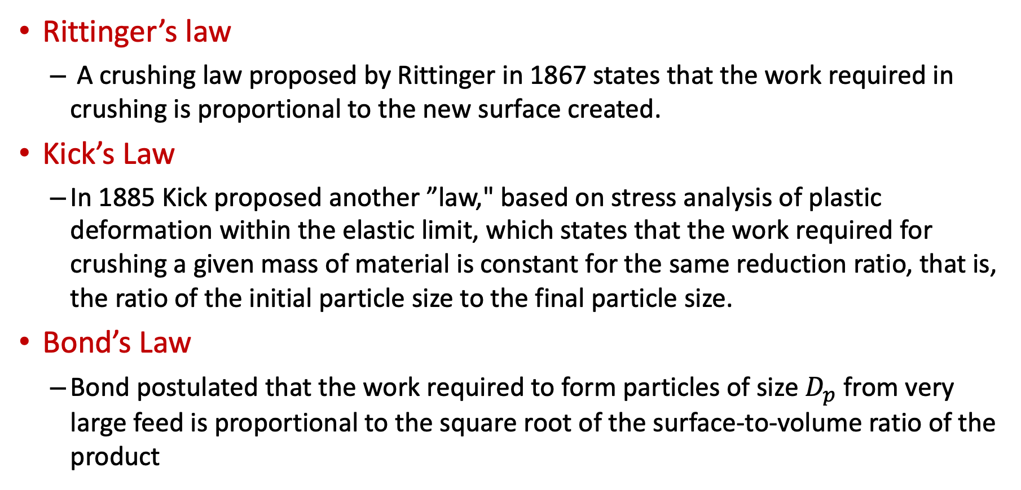
Different empirical laws for size reduction
Rittinger’s law
  A crushing law proposed by Rittinger in 1867 states that the work required in crushing is proportional to the new surface created.
Kick’s Law
  In 1885 Kick proposed another ”law," based on stress analysis of plastic deformation within the elastic limit, which states that the work required for crushing a given mass of material is constant for the same reduction ratio, that is, the ratio of the initial particle size to the final particle size.
Bond’s Law
  Bond postulated that the work required to form particles of size $D_{p}$ from very large feed is proportional to the square root of the surface-to-volume ratio of the product

Slide 17
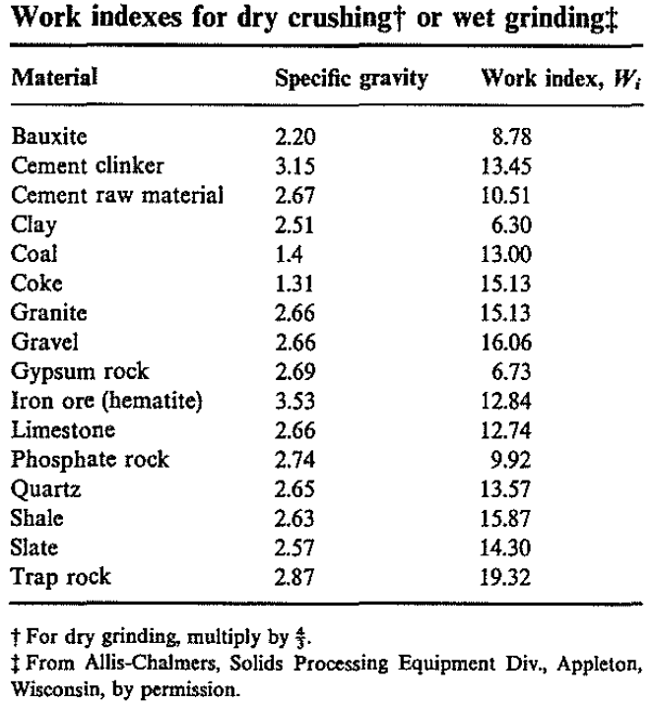
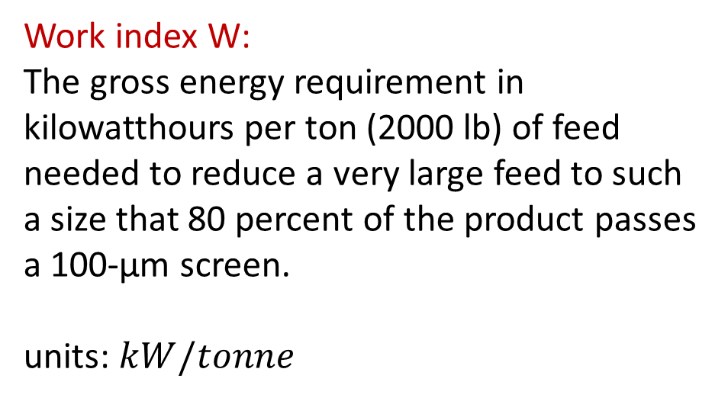
WORK INDEX
Work index W:
The gross energy requirement in kilowatthours per ton (2000 lb) of feed needed to reduce a very large feed to such a size that 80 percent of the product passes a 100-µm screen.
units: $kW/tonne$

Slide 19

Summary of empirical laws
Rittinger’s law
$$\frac{P}{\dot{m}}=K_{R}\left(\frac{1}{{\overline{D}}_{Sb}}−\frac{1}{{\overline{D}}_{Sa}}\right)$$
Kick’s Law
$$\frac{P}{\dot{m}}=K_{K}\ln\left(\frac{{\overline{D}}_{Sa}}{{\overline{D}}_{Sb}}\right)$$
Bond’s Law
$$\frac{P}{\dot{m}}=K_{B}\left(\frac{1}{\sqrt{D_{pb}}}−\frac{1}{\sqrt{D_{pa}}}\right)$$
$$=0.3162W_{i}\left(\frac{1}{\sqrt{D_{pb}}}−\frac{1}{\sqrt{D_{pa}}}\right)$$

Slide 20
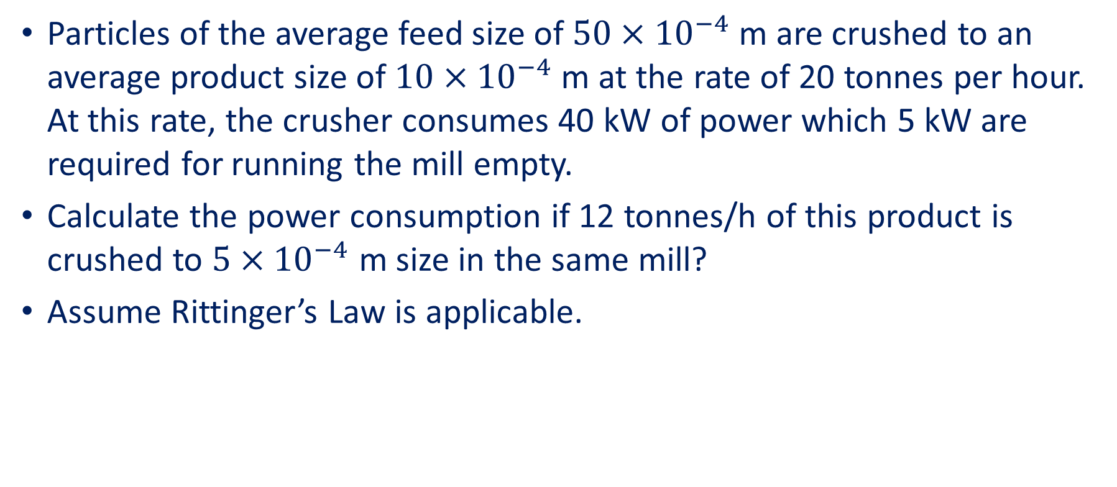
Problem 1: Size reduction
Particles of the average feed size of $50×{10}^{−4}$ m are crushed to an average product size of $10×{10}^{−4}$ m at the rate of 20 tonnes per hour. At this rate, the crusher consumes 40 kW of power which 5 kW are required for running the mill empty.
Calculate the power consumption if 12 tonnes/h of this product is crushed to $5×{10}^{−4}$ m size in the same mill?
Assume Rittinger’s Law is applicable.

Slide 21
References
Smith, J., Harriott, P., McCabe, W. (2005). Unit Operations of Chemical Engineering. Colombia: McGraw-Hill Education.
Swain, A. K., Patra, H., & Roy, G. K. (2011). Mechanical operations. Tata McGraw Hill.

